Slide 1
Optical Tweezers and their use on dsDNA
By Alex DelBene

Slide 2
Overview
Optical Tweezers
History
Theory of optical trapping
Set up of optical tweezers
Potential drawbacks
Studying DNA with Optical Tweezers
Rundown of DNA terminology
Experiments and results
Other applications for Optical Tweezers

Slide 3
Optical Tweezers
Notes:
Starting with optical tweezers
Optical tweezers are typically defined as an optical trap consisting of a singular laser beam that is able to trap particles
Dual-beam optical tweezers also are used in some experiments, so the definition of optical tweezers has broadened to be more similar to just optical trapping in general

Slide 4
History
Arthur Ashkin
First observation of acceleration of freely suspended particle from radiation pressure
Historically hard to study radiation pressure due to thermal forces (radiometric forces)
Able to overcome radiometric forces
Ashkin found a beam hitting a 2.68 μm transparent bead suspended in water caused the bead to move towards the beam axis and with the light
When laser was blocked, bead would move away due to Brownian Motion
Notes:
1st
Arthur Ashkin is referred to as the father of the optical tweezers and recently in 2018 he was awarded part of the Nobel Prize in Physics for his discovery of optical tweezers
His paper titled Acceleration and Trapping of Particles by Radiation Pressure published in 1970 laid down the groundwork for optical trapping. His work throughout the 70’s and early 80’s allowed us to develop the optical tweezers as we know them today
2nd
It’s historically been hard to study the effects of radiation pressure due to thermal forces referred to as radiometric forces. Radiometric forces are caused by temperature gradients in the surrounding medium. These thermal forces used to obscure all effects of radiation pressure due to the fact that the radiometric forces were orders of magnitude larger than the forces of radiation pressure, with radiation pressure being on the pN scale
Photophoresis is a term used to indicate that that the thermal gradients in the medium are caused by light, the laser in this case.
3rd
Ashkin was able to overcome the radiometric forces by choosing a relatively transparent particle and medium. This meant there was less thermal absorption and thus a lower temperature in the system
Now being able to study radiation pressure without overwhelming interference, Ashkin found a beam hitting a 2.68 micrometer transparent bead suspended in water caused the bead towards the center of the beam, the beam axis, and away from the source of the laser
This is due to gradient and scattering forces that I will be discussing in an upcoming slide
When the laser was blocked, the bead was observed moving off due to Brownian motion. This just confirms that the motion seen from the bead were due to radiation pressure from the laser

Slide 5
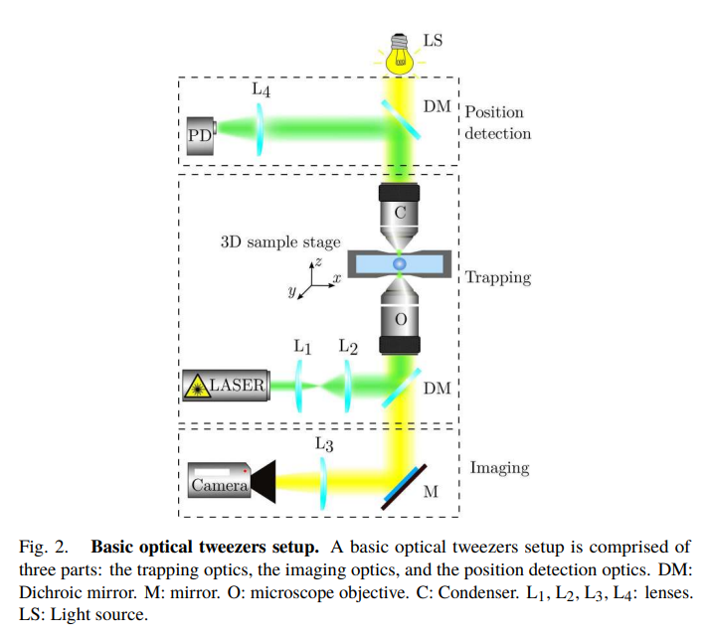
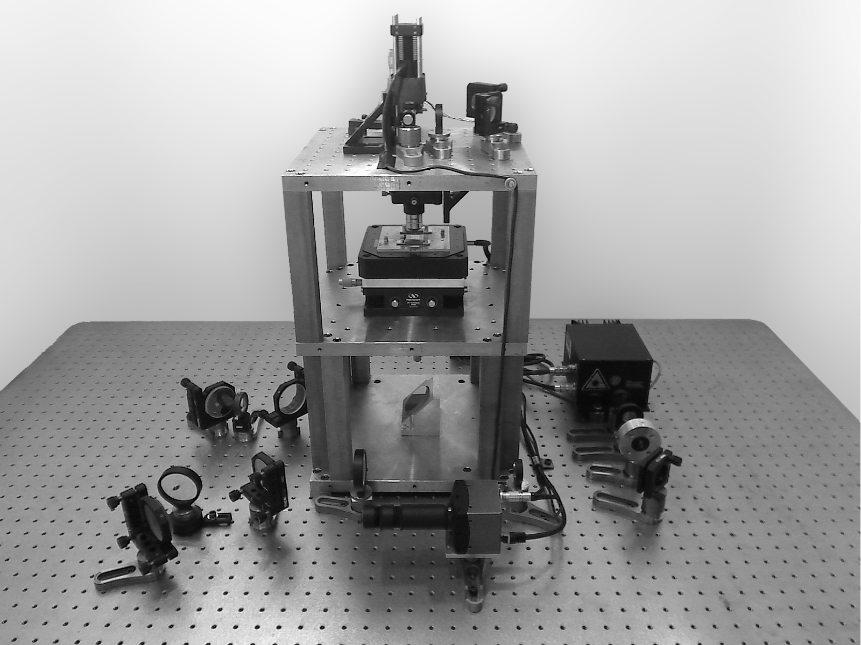
Pesce, G. et al. A Step-by-step Guide to the Realisation of Advanced Optical Tweezers
Notes:
Left
Diagram of a simple optical tweezers set up
Laser passes through a set of lenses that act as a beam widener
Dichromatic mirrors used as alignment mirrors, dichromatic means that they allow certain wavelengths of light through and reflect others
This allows the light needed for the video analysis to pass through the mirrors and make it to the camera
The laser light is then passed through a microscope objective with a NA appropriate for the experiment
The optical trap is created and the light goes through a condenser and is directed to a position detector
Right
This is a picture of an optical tweezers set up in an actual lab setting
The set up is fairly small, but it is difficult to find pictures of real life optical tweezers so the size could potentially be dependant on the experiment

Slide 6


Theory of Optical Trapping
n_{p} > n_{m}
Conservation of momentum
Trap potential
Harmonic potential - restoring force is proportional to displacement
Probability distribution in a harmonic potential is Gaussian
Probability distribution matches expected position
Notes:
1st
For optical trapping set ups to work, the refractive index of the particle must be larger than the refractive index of the medium
This means that the velocity of the light slows down upon entering the bead. This is a change in momentum of the light
2nd
Looking at conservation of momentum, the change in momentum of the light upon entering the bead will cause a change in momentum of the bead
This exchanging of momentum is what allows for particles to be optically trapped

Slide 7


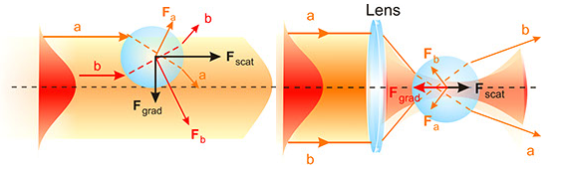
Scattering and gradient forces
Gradient of laser causes bead to be pulled to the beam axis, scattering pushes the bead
R_{i} and T_{i} are reflection and transmission coefficients, P_{i} is the power, θ_{i} hat and r_{i} hat are incidence and transmission angles
Arias-Gonzalez J. Optical Tweezers, Optical Nanomanipulation Lab

Slide 8
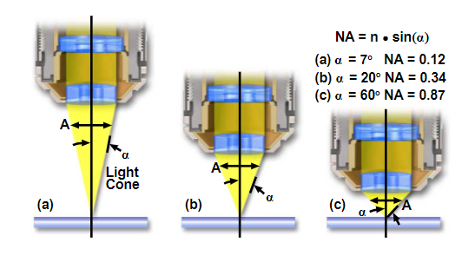
Optical Tweezers Set Up
Numerical Aperture of Objective
Describes cone of light going through microscope objective
Optical tweezers typically have a high NA objective, but low NA objectives have been used as well
NIR laser
Near Infrared lasers (750-1200 nm) typically used to lower the amount of radiation damage on an organic sample
May not be the case for other types of experiments
Davidson, M. W. Numerical Aperture, Nikon’s MicroscopyU

Slide 9
Optical Tweezer Drawbacks
NIR laser localized heating
NIR lasers cause localized heating around the object that can modify properties of the DNA
Increase Brownian motion
Brownian motion
The random motion of particles suspended in a medium due to the collision with the molecules in the medium
Objects in optical trap can experience Brownian motion
Notes:
1st
One of the first drawbacks to using optical tweezers in situations with organic materials is the localized heating in the medium around the particle caused by NIR lasers. The increase in temperature can cause chemical properties of the DNA to be changed and thus can make data collection difficult
This drawback is less than what would occur if a lower wavelength laser was used
2nd
Another drawback is having to deal with and account for Brownian motion of the particle
Brownian motion is the random motion of particles that are suspended in a medium that is caused by collisions with the particles of the medium
At higher temperatures, the particles of the medium have higher energy, so Brownian motion is more noticeable
Beads trapped in an optical trap undergo Brownian motion. To see the stability of a trap and whether or not it will be able to account for the Brownian motion the trapping potential and thermal energy are compared
An optical trap is considered stable if the trapping potential is larger than the thermal energy

Slide 10
Overstretching DNA with Optical Tweezers

Slide 11
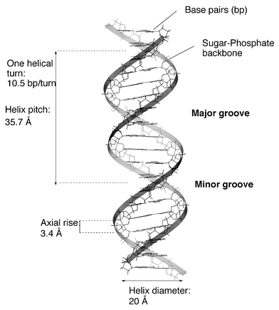
DNA Basics
B-DNA
Right hand helix
Rise per base pair of 3.4 Angstrom
dsDNA = double stranded DNA
Contour length
# of nucleotides x length of nucleotides
Length of DNA fully laid out
Belmont, P. et al. Nucleic acid conformation diversity: from structure to function and regulation

Slide 12
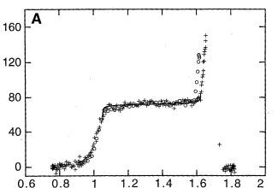
Stretching of DNA
Stretching pre-expansion
“A force of 2-3 pN is able to stretch B-DNA to 90% of it’s contour length”
Force rises rapidly the closer the length is to the contour length
Expansion
Contour length increase by approximately 1.7 times
Increase in rise per base pair from 3.4 to 5.8 Angstrom
Transition occurs on very narrow force range (~2 pN)
Stretching post-expansion
Remains stretched and behaves as before
Force (pN)
Relative Length
Cluzel, P. et al. DNA: An Extensible Molecule

Slide 13
Conclusions
Overstretching B-DNA
Unwinding of DNA strands to form unpaired ladder
Cooperativity of transition means that the extended regions are larger and homogeneous
Must be energetically easier to spread an existing region rather than nucleate a new one
DNA: An Extensible Molecule
Two separate states pre and post expansion (B-DNA to S-DNA)
Experimental outcome matched JUMNA prediction
JUMNA suggests transition includes reduced diameter of the helix and an increase in base pair inclination
Notes:
Actual mechanism unknown and the most popular explanations are expressed by these 2 articles
JUMNA- molecular modeling program

Slide 14
Other Applications of Optical Tweezers
Study proteins
Similar experiments
Cooling of atoms
Control velocity
mK level cooling
Manipulation of neurons
Study individual synapses with auxiliary particles
Notes:
1st
Optical tweezers can be found all over singer molecular biophysics. Another application outside of DNA are experiments done on various proteins. The small amount of forces achievable by use of optical trapping can be used to experiment with protein folding
2nd
Another application is the cooling of individual atoms or molecules. This is done by the controlling of the velocity of the particle. These particles are very small, and since temperature can be thought of as the average kinetic energy, the velocity is proportional to the temperature
Cooling using optical trapping with laser light is capable of bringing atoms down to micro kelvin level temperatures
This has assisted in the accuracy of atomic clocks
3rd
Neuroscience has also found a use for optical tweezers
The low forces that can be generated from optical tweezers are ideal for the manipulation of single neurons and allow for structural study
Use of auxiliary particles can also allow researchers to study individual synapses of neurons

Slide 15
References
https://www.jstor.org/stable/2889889?seq=1#metadata_info_tab_contents
https://journals.aps.org/prl/pdf/10.1103/PhysRevLett.24.156
https://www.sciencedirect.com/science/article/pii/S0006291X18300998?#fig4
https://bio.libretexts.org/Bookshelves/Genetics/Book%3A_Working_with_Molecular_Genetics_(Hardison)/Unit_I%3A_Genes_Nucleic_Acids_Genomes_and_Chromosomes/2%3A_Structures_of_Nucleic_Acids/2.5%3A_B-Form_A-Form_and_Z-Form_of_DNA
https://www.mdpi.com/2072-666X/12/8/954/htm
https://arxiv.org/pdf/2004.05246.pdf
https://citeseerx.ist.psu.edu/viewdoc/download?doi=10.1.1.460.7282&rep=rep1&type=pdf
https://www.ncbi.nlm.nih.gov/pmc/articles/PMC24595/
https://www.frontiersin.org/articles/10.3389/fbioe.2020.602797/full#h4

